Slide 1
UI/UX Design
Lesson 3: UI/UX Design III
Presented by Krystal Educational Platform

Slide 2
Lesson Outline
Learn about Penpot object basic function
Learn about Penpot grids, styling, color basic function
Understand how to exporting the file in Penpot
Use the learned basic function knowledge on practical examples

Slide 3
Contents
3.1
Penpot Object Basic
3.3
Penpot Styling Basic
3.5
Penpot Exporting Objects
3.2
Penpot Grids Basic
3.4
Penpot Color Setting

Slide 4
Penpot Object Basic
3.1

Slide 5
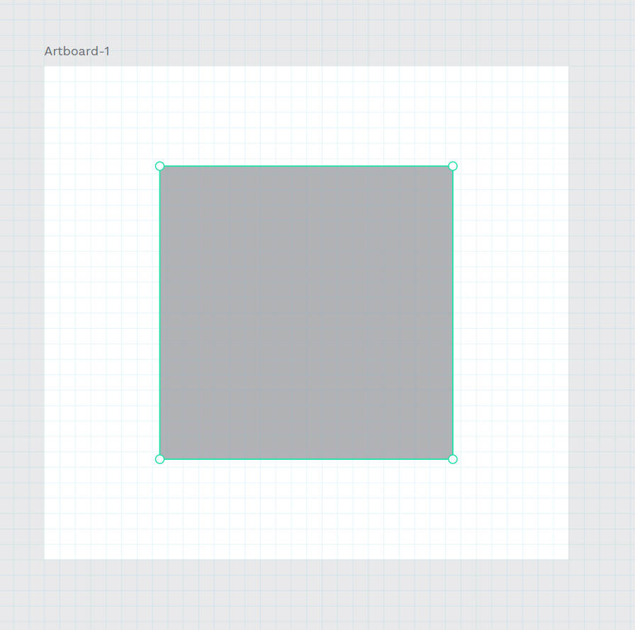
3.1 Penpot Object Basic
Objects
Objects are items that you can place in the viewport. Artboards, shapes, texts, paths and graphics are objects.
Artboards
An artboard is a frame with fixed edges. Artboards are useful if you want to design for a specific screen or print size. Objects inside artboards only show the parts that fall within its shape.
Picture © https://help.penpot.app/user-guide/

Slide 6
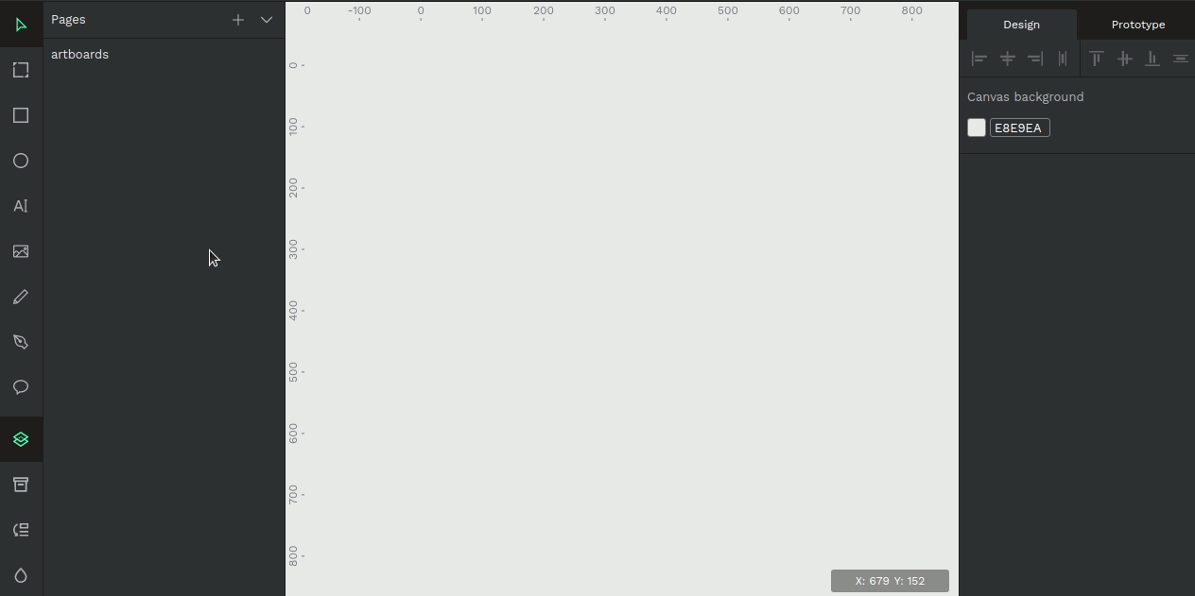
3.1 Penpot Object Basic
Create artboards
You can create an artboard with a custom sizes or choose one of the provided presets with the most common resolution for devices and standard print sizes.
Picture © https://help.penpot.app/user-guide/

Slide 7
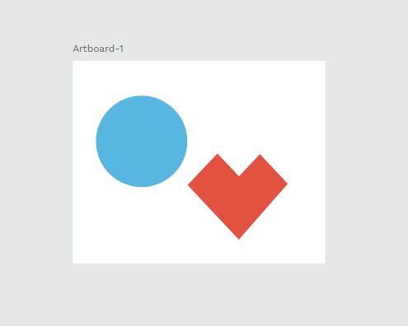
3.1 Penpot Object Basic
Select and move artboards
Click on the artboard name or double click over an area without layers.
To move an artboard you have to select it first and then drag it from its name or from an area without layers.
Picture © https://help.penpot.app/user-guide/

Slide 8
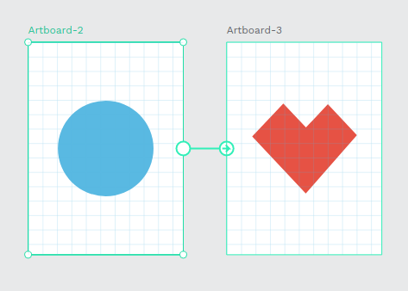
3.1 Penpot Object Basic
Grids and prototyping
Artboards have two additional features: you can set grids on them to assist with aligning objects, and you can connect them to each other to create interactions.
Picture © https://help.penpot.app/user-guide/

Slide 9
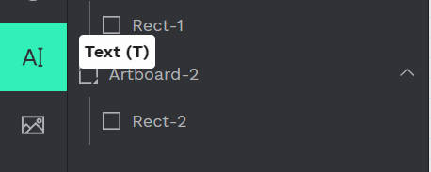
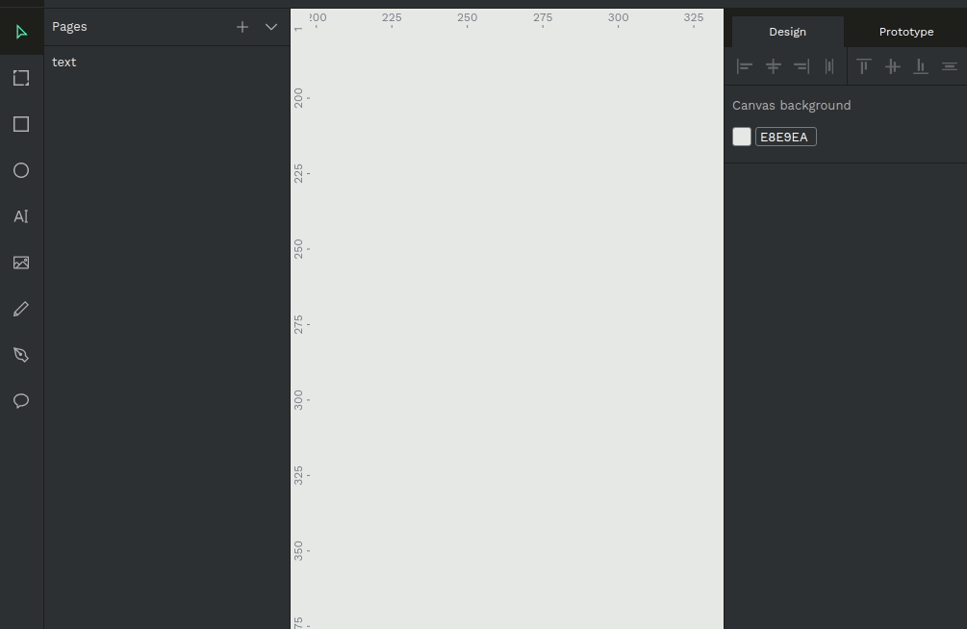
3.1 Penpot Object Basic
Text
To insert the text you have to activate the text tool by first clicking on the icon at the toolbar or pressing T. Then you have two ways to create a text layer:
Click to create a textbox without any specific dimensions.
Drag to create a textbox with a fixed size.
Picture © https://help.penpot.app/user-guide/

Slide 10
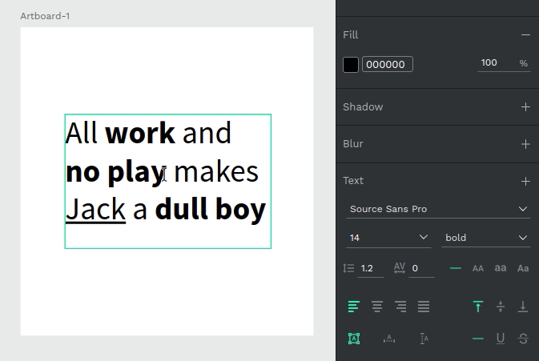
3.1 Penpot Object Basic
Text
Edit and style text content
Press Enter with a text layer selected to start editing the text content. You can style parts of the text content as rich text.
Picture © https://help.penpot.app/user-guide/

Slide 11
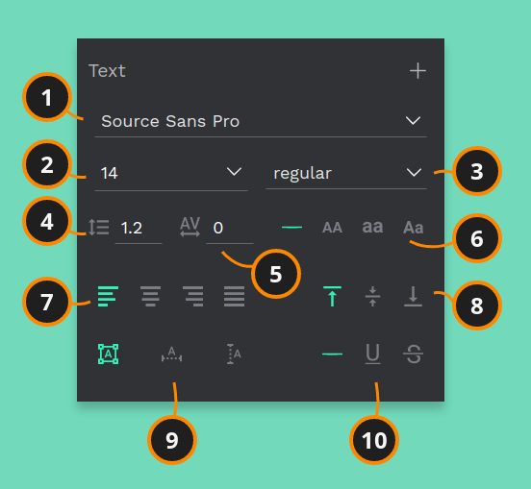
3.1 Penpot Object Basic
Text options
1)Font family: You can choose any font from Google Fonts.
2) Font size
3) Font type
4) Line height : (in pixels).
5) Letter spacing : (in pixels).
6) Text case: none, uppercase, lowercase, title case.
7) Horizontal alignment: left, center, right, justify.
8) Vertical alignment: top, center, bottom.
9) Sizing: auto height, auto width, fixed size.
10) Text decoration: none, underline, strikethrough.
Picture © https://help.penpot.app/user-guide/

Slide 12
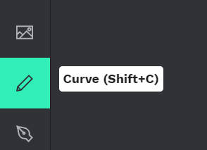
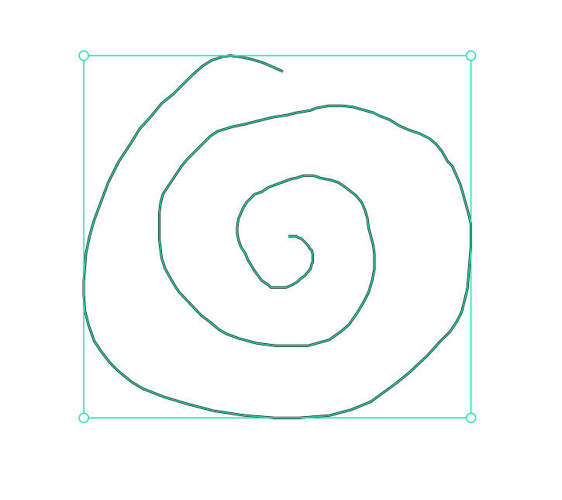
3.1 Penpot Object Basic
Curves (freehand)
The curve tool allows a path to be created directly in a freehand mode. Select the curve tool by clicking on the icon at the toolbar or pressing Shift+ c.
The path created will contain a lot of points, but it is edited the same way as any other curve.
Picture © https://help.penpot.app/user-guide/

Slide 13
Penpot Grids Basic
3.2

Slide 14
3.2 Penpot Grids Basic
Grids and layouts
Grids are design aids that are used to help you to align content to a geometric structure. In Penpot there are three types of grids: square, columns and rows.
Note: Grids are only visible in the viewport and will never be shown on exports.

Slide 15

3.2 Penpot Grids Basic
Creating Layout Grids
Grids are created at the artboards level. To create a grid on artboard, select the artboard. In the Design panel there is a section for "Grids & Layouts". Click the "+" button to add a grid to the artboard. You can add as many grids as you want.
Picture © https://help.penpot.app/user-guide/

Slide 16
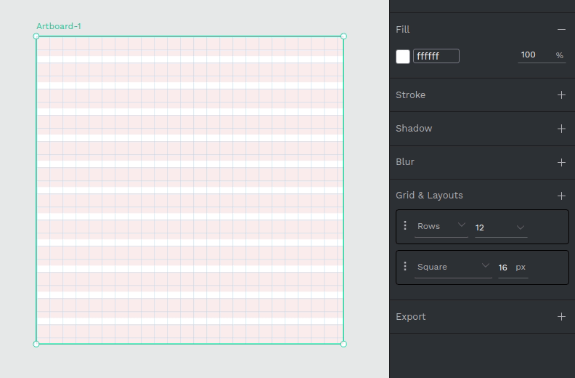
3.2 Penpot Grids Basic
Hide and Remove Grids
You can hide an specific grid by clicking at the eye button of a grid configuration. If you want to remove a grid, use the "-" button at the right side of the grid pill.
Picture © https://help.penpot.app/user-guide/

Slide 17
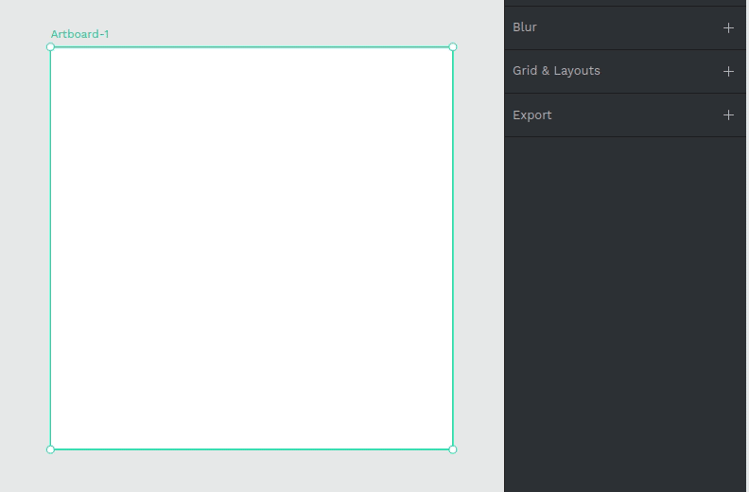
3.2 Penpot Grids Basic
Square Grid
The options for square or rectangular grids are:
Size (in pixels)
Color
Opacity
Picture © https://help.penpot.app/user-guide/

Slide 18
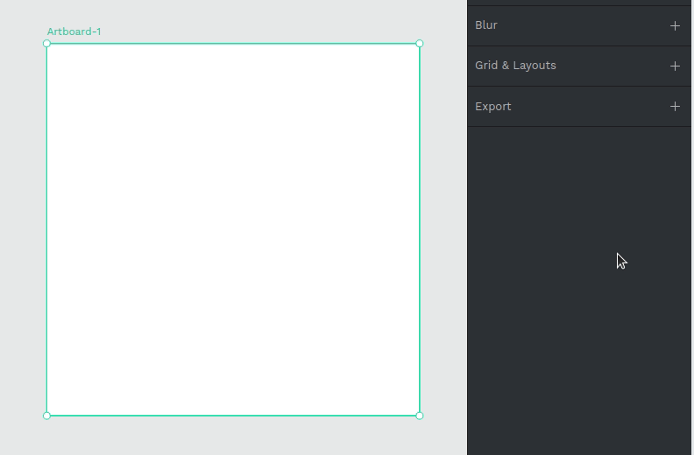
3.2 Penpot Grids Basic
Row Layouts
The options for row layouts are:
Rows
Type - stretch, top, center bottom
Height - "auto" by default.
Gutter - the space between each row.
Margin ,Color, Opacity
Picture © https://help.penpot.app/user-guide/

Slide 19
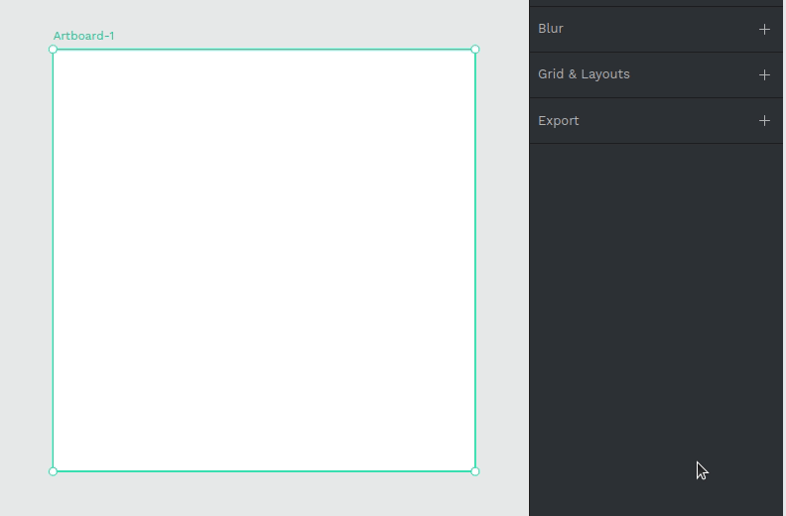
3.2 Penpot Grids Basic
Column Layouts
Options for column layouts are:
Columns
Type - stretch, top, center bottom
Width - "auto" by default.
Gutter - the space between each column.
Margin, Color, Opacity
Picture © https://help.penpot.app/user-guide/

Slide 20
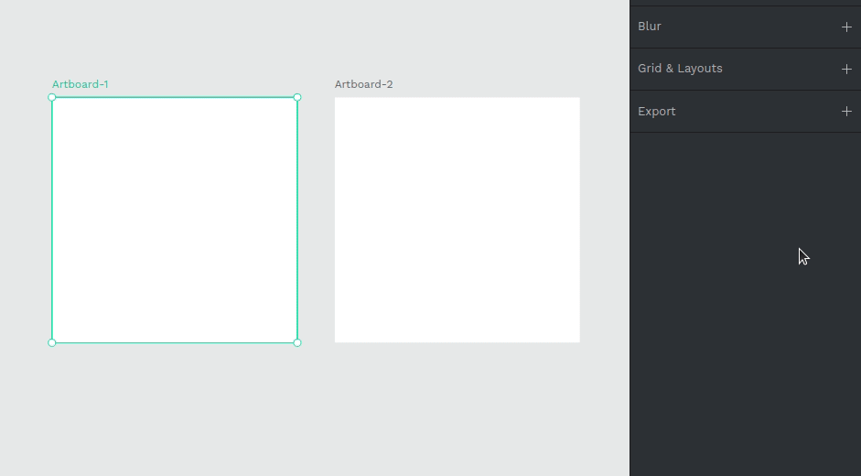
3.2 Penpot Grids Basic
Grid Defaults
There are default settings available at file level. You can change the settings of a grid to the file defaults by using the "Use default" button. You can also set a grid to be the default by using the "Set as default" button.
Picture © https://help.penpot.app/user-guide/

Slide 21
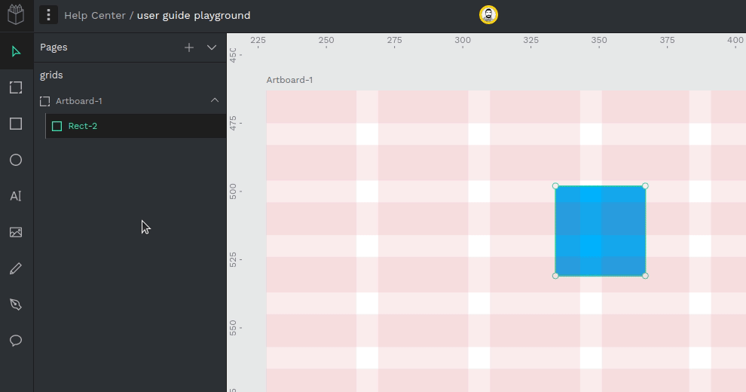
3.2 Penpot Grids Basic
Snap to Grid and Visibility
To hide or show all the grids at a file you can press Ctrl/⌘ + ´ or use the option at the main menu at the top left of the navbar.
If you want to enable or disable the snapping to grids you can press Shift/⇧ + Ctrl/⌘ + ´ or use the option at the main menu at the top left of the navbar.
Picture © https://help.penpot.app/user-guide/

Slide 22
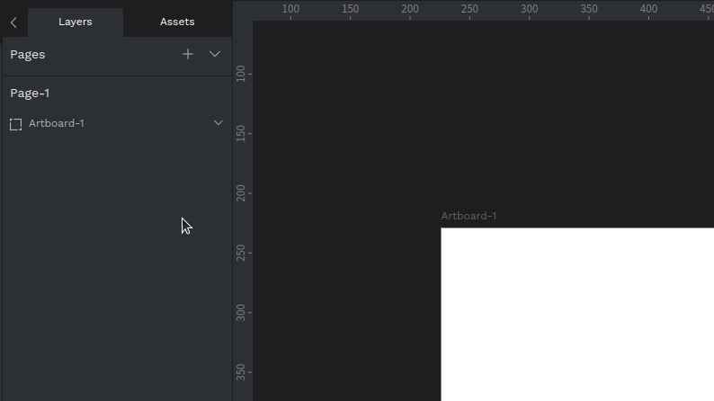
3.2 Penpot Grids Basic
Guides
To create guides click anywhere on the ruler an drag to some point of the viewport. Click on the vertical ruler to create a vertical guide and the horizontal ruler to you know what.
To delete guides drag the guide to the ruler or select the guide and press delete / supr.
To show/hide guides use the same shortcut as for rules: Shift/CMD + Ctrl + R
Picture © https://help.penpot.app/user-guide/

Slide 23
Penpot Styling Basic
3.3

Slide 24
3.3 Penpot Styling Basic
Styling
Penpot has a variety of styling options for each object. When selected, the styling options are displayed in the design panel on the right.

Slide 25
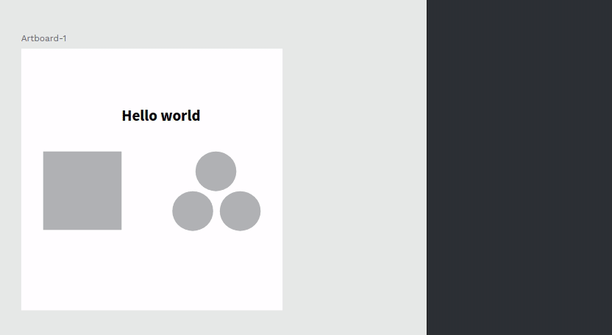
3.3 Penpot Styling Basic
Fill
Color fills can be added to artboards, shapes, texts and groups of layers. A fill can be a custom color (in Hex) or a color style from a library.
To apply a fill you can use the color picker, the color palette or a color styles.
You can also set the opacity for custom fill colors.
Picture © https://help.penpot.app/user-guide/

Slide 26

3.3 Penpot Styling Basic
Remove a Fill
To remove a fill from a selected object, press the “-” button in the fill section.
Picture © https://help.penpot.app/user-guide/

Slide 27

3.3 Penpot Styling Basic
Strokes
Strokes can be added to most of the objects at Penpot (rectangles, ellipses, artboards, curves and images).
Picture © https://help.penpot.app/user-guide/

Slide 28

3.3 Penpot Styling Basic
Stroke Caps
Ever needed an arrow to point something? You can style the ends of any open paths selecting different styles for each end of an open path.
Picture © https://help.penpot.app/user-guide/

Slide 29
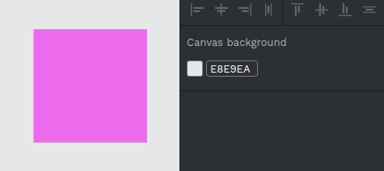
3.3 Penpot Styling Basic
Border radius
Border radius can be applied to rectangles and images to edit its corners. There’s also the option to edit each corner individually.
Picture © https://help.penpot.app/user-guide/

Slide 30
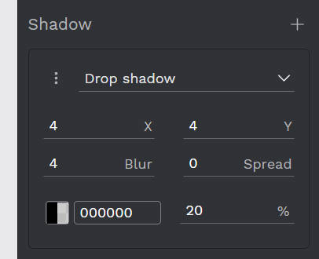
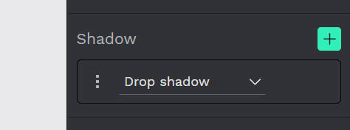


3.3 Penpot Styling Basic
You can be adding shadows from the shadow button.
There have two types of shadows:
Drop Shadow
Inner Shadow
Picture © https://help.penpot.app/user-guide/

Slide 31
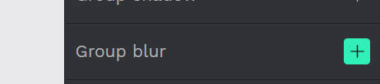
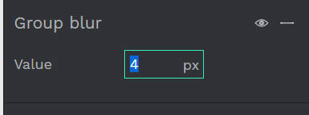

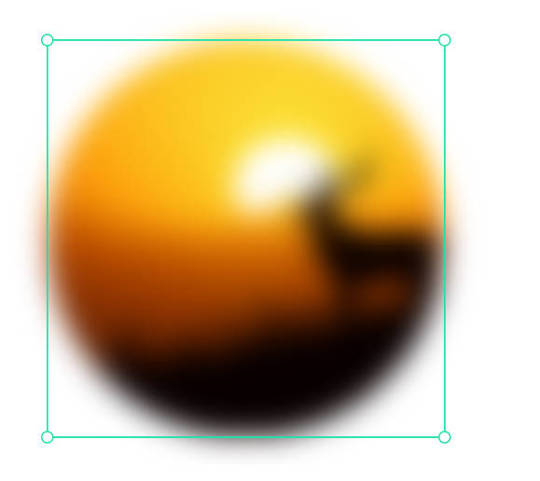
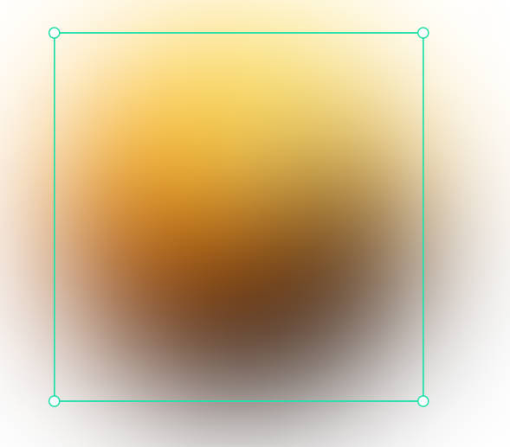
3.3 Penpot Styling Basic
Blur
You can set a blur for each and every object at Penpot.
editing the px to change the blues values.
Picture © https://help.penpot.app/user-guide/

Slide 32
Penpot Color Setting
3.4

Slide 33
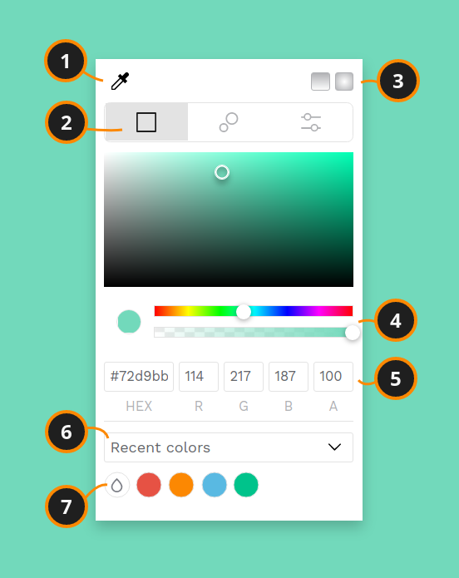
3.4 Penpot Color Setting
In Penpot there are two main tools to manage color: the color picker and the color palette.
Color picker
Color Palette
Picture © https://help.penpot.app/user-guide/

Slide 34
3.4 Penpot Color Setting
1) Eyedropper - Allows you to pick any color of the objects at the viewport.
2) Color profiles - Select between RGB, the Harmony Wheel or HSV.
3) Gradients - Set linear or radial gradients.
4) Sliders - Easily manage color and opacity.
5) Values - Set precise color values of red(R), green(G), bylue(B) and transparency(A).
6) Shortcuts - Switch between recent colors and libraries.
7) Color palette - A quick launcher of the palette with the selected library.
Picture © https://help.penpot.app/user-guide/

Slide 35
Penpot Exporting Objects
3.5

Slide 36
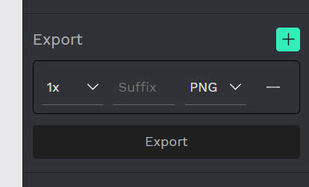
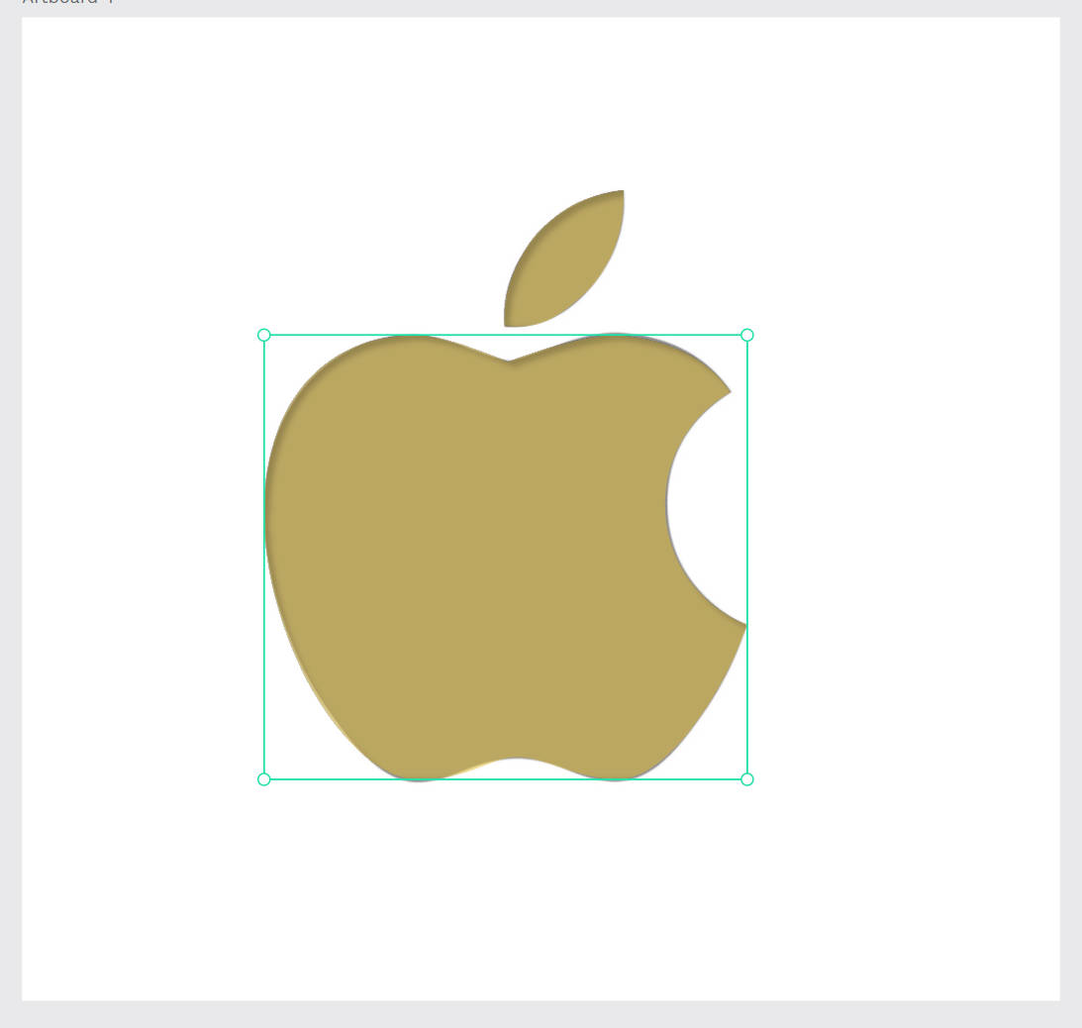

3.5 Penpot Exporting Objects
In Penpot you can setup export presets for different file formats and scales.
How to Export
To export an object you need to select it and at the Design, panel add an export preset by pressing the “+” button of the Export section.
Screenshot © https://help.penpot.app/user-guide/

Slide 37
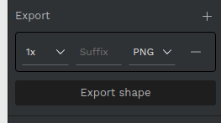
3.5 Penpot Exporting Objects
Remove Export Preset
To remove an export presets you have to select the object and then press the “-” button at the export preset you want to remove.
Screenshot © https://help.penpot.app/user-guide/

Slide 38
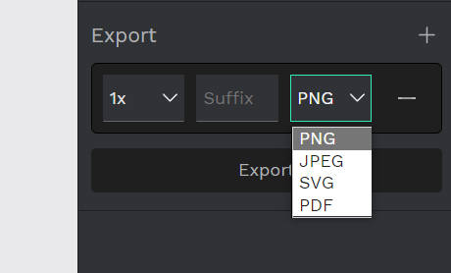
3.5 Penpot Exporting Objects
Export options
Size - Options for the most common sizing scales.
Suffix - Especially useful if you are exporting at different scales.
File format - PNG, SVG, JPEG, PDF.
Screenshot © https://help.penpot.app/user-guide/

Slide 39
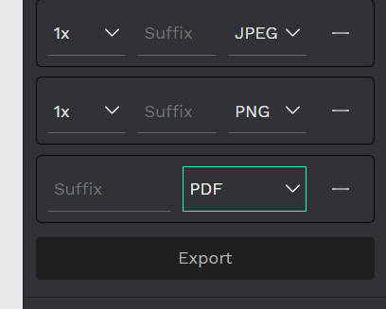
3.5 Penpot Exporting Objects
Multiple Export Presets
You can set as many exports presets you need for the same object. Set multiple exports to get the same object in different scales and/or formats with just one click.
Screenshot © https://help.penpot.app/user-guide/

Slide 40
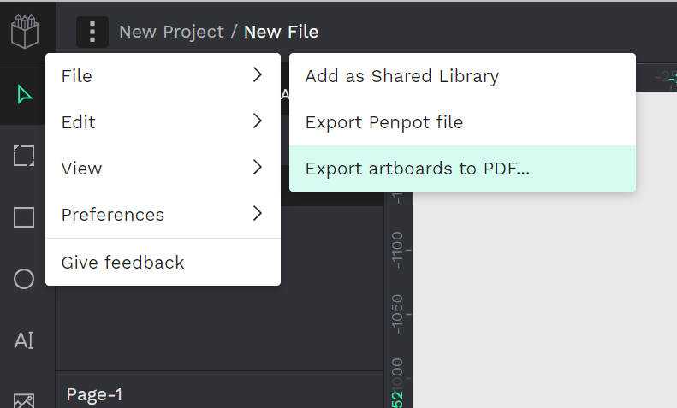
3.5 Penpot Exporting Objects
Export Artboards to PDF
If you have a presentation made at Penpot you might want to create a document that can be shared with anyone, regardless of having a Penpot account, or just to be able to use your presentation offline . You can easily export all the artboards of a page to a single pdf file from the file menu.
Screenshot © https://help.penpot.app/user-guide/

Slide 41
Penpot Asset Libraries
3.6

Slide 42
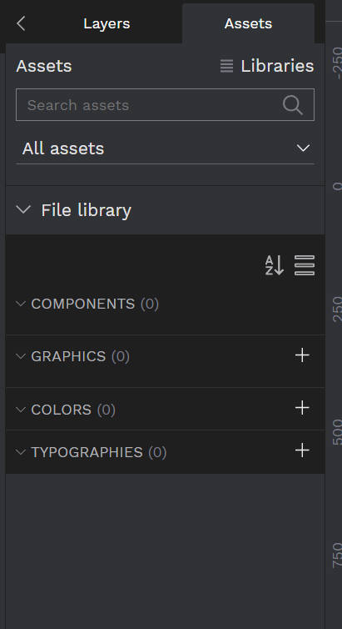
3.6 Penpot Asset Libraries
Asset Libraries allow you to store elements and styles so that they can be easily reused. Libraries may include components, graphics, colors and typographies. Learn how to create and manage them to better organize the pieces of your designs and speed your workflow.

Slide 43
3.6 Penpot Asset Libraries
File library
Each file has a File Library that allows assets that belong to it to be stored. You can find File Libraries at the workspace. To access them, click the assets panel icon at the bottom of the left toolbar or press Alt/⌥ + i.

Slide 44
3.6 Penpot Asset Libraries
Asset Types
Components: A component is an object or group of objects that can be reused multiple times across user files.
Graphics: Both bitmap and vector images can be stored at the Graphics section.

Slide 45
3.6 Penpot Asset Libraries
Asset Types
Colors: Create your color styles and use them on fills and strokes.
Typographies: Penpot allows you to save typography styles with a set of reusable properties. You can always unlink a typography style maintaining the properties for the text layer.

Slide 46
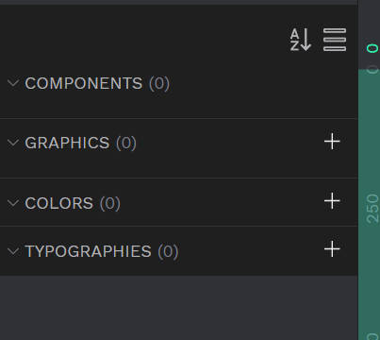
3.6 Penpot Asset Libraries
Adding Assets to Libraries
You can use the “+” icon to add assets. Each of the categories have their own specific action:

Slide 47
3.6 Penpot Asset Libraries
Adding Assets to Libraries
You can use the “+” icon to add assets. Each of the categories have their own specific action:

Slide 48
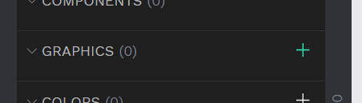
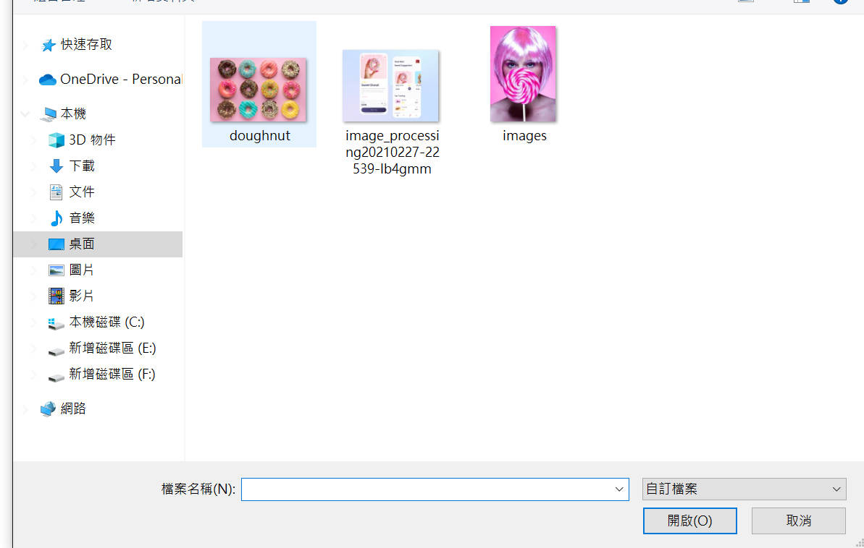
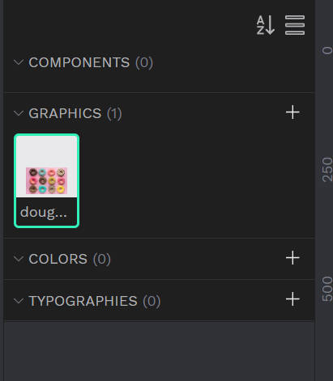
3.6 Penpot Asset Libraries
Adding Graphics Assets to Libraries
Press + button to choose the graphics you want to Add to the graphics assets. You can select one and more graphics in the assets libraries.

Slide 49
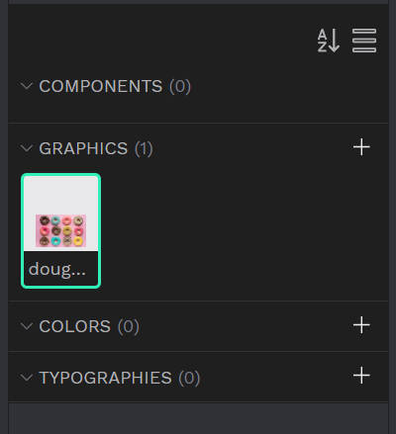
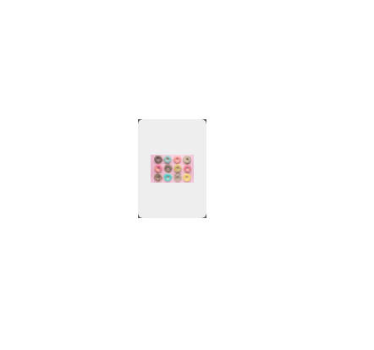
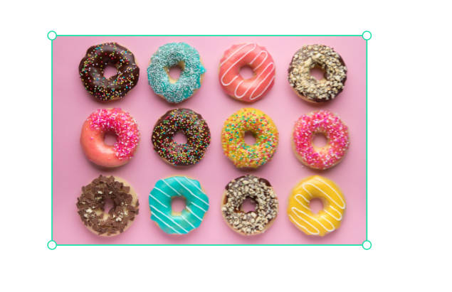
3.6 Penpot Asset Libraries
Using the Graphics Assets on Libraries
Select the assets you want to use, after selecting, drag the graphic to the artboard inside and let go, the graphic will appear and you can use it.

Slide 50
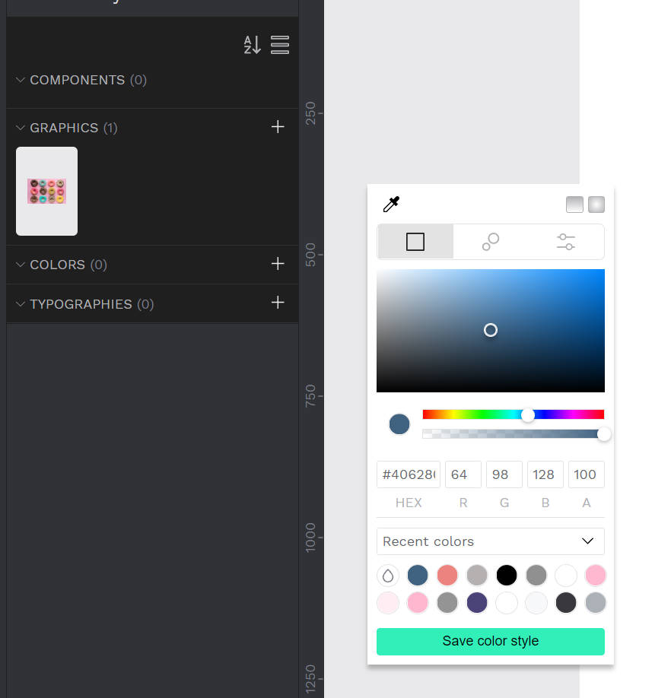
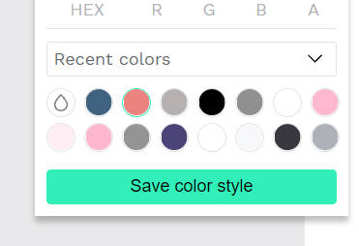
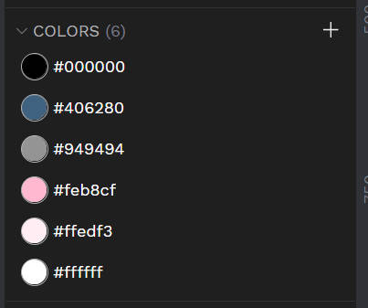
3.6 Penpot Asset Libraries
Adding Color Assets on Libraries
Select the Color you want to adding, after selecting, press the save color style button, after that the color style will save in colors assets and you can use it for anytime.

Slide 51
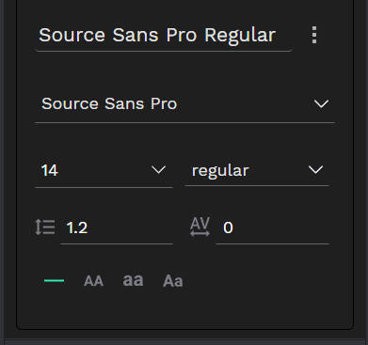
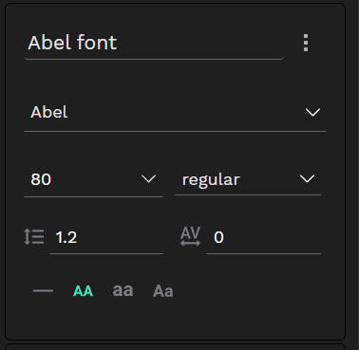
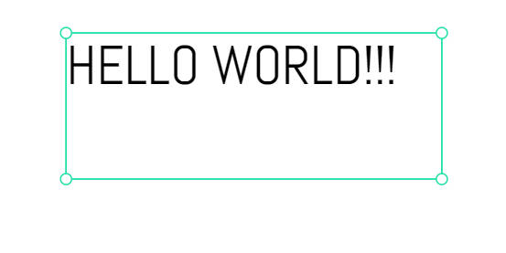
3.6 Penpot Asset Libraries
Adding Typographies Assets on Libraries
Adding the typographies, it has a default setting, you can change the typographies detail setting like name, font, font size, line height, letter spacing…Etc.

Slide 52
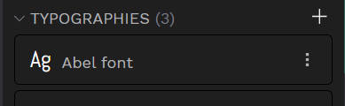
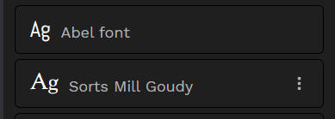
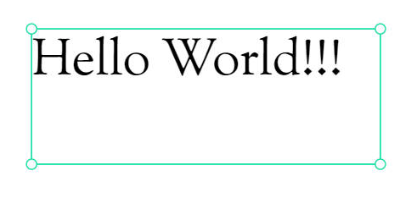


3.6 Penpot Asset Libraries
Using Typographies Assets on Libraries
After you Add the typographies assets to libraries, You can create one or more typographies assets for yourself, when you want to use the typographies, just right-click the name two times, also you can use the color asset to change the font color.

Slide 53
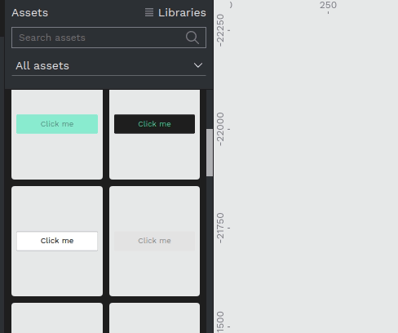
3.6 Penpot Asset Libraries
Edit assets
Press left click over any asset of the library to show the options menu. Some options are available only for certain assets.
Components: Rename, duplicate, delete, group.
Graphics: Rename, delete, group.
Colors: Rename, edit, delete.
Typographies: Rename, edit, delete.
Screenshot © https://help.penpot.app/user-guide/

Slide 54

3.6 Penpot Asset Libraries
Manage and organize libraries
Learn how to better view and organize your assets:
View modes (list and grid)
You can switch between list and grid views.
Grid view: With the thumbnails displayed is easier to visually identify the content of specific assets, specially components.
List view: Optimized to identify the assets by their names and view more assets at the same time.
Screenshot © https://help.penpot.app/user-guide/

Slide 55

3.6 Penpot Asset Libraries
Ordering
Click the ordering button to change the alphabetical order.
Screenshot © https://help.penpot.app/user-guide/

Slide 56

3.6 Penpot Asset Libraries
Search assets
Use the Search assets box to filter the assets with names that match what you write.

Slide 57

3.6 Penpot Asset Libraries
Filter assets
You can decide whether to show all asset types or only one (components, graphics, colors or typographies).
Screenshot © https://help.penpot.app/user-guide/

Slide 58

3.6 Penpot Asset Libraries
Multiselect assets
Press Ctrl/⌘ + left click to select multiple assets and be able to perform operations on them simultaneously.

Slide 59

3.6 Penpot Asset Libraries
Grouping assets
Penpot allows you to create groups inside libraries. To create a group, use the slash-separated naming convention and the group will be created automatically. e.g. group / subgroup / asset_name.
Another way to create a group is to right click with more than one asset selected and then click “Group” in the contextual menu.

Slide 60
Prototyping interactions
3.7

Slide 61

3.7 Prototyping interactions
Interaction triggers
The trigger defines the user action that will start the interaction.
On click: when user clicks or tap the hotspot.
Mouse enter: when the mouse enter the hotspot area.
Mouse leave: when the mouse leaves the hotspot area.
After delay: when a certain time has passed after an artboard is shown. Note: this can only be set at artboards.

Slide 62

3.7 Prototyping interactions
Interaction triggers
On click: when user clicks or tap the hotspot.

Slide 63

3.7 Prototyping interactions
Interaction triggers
Mouse enter: when the mouse enter the hotspot area.

Slide 64

3.7 Prototyping interactions
Interaction triggers
After delay: when a certain time has passed after an artboard is shown. Note: this can only be set at artboards.

Slide 65

3.7 Prototyping interactions
Interaction triggers
After delay: when a certain time has passed after an artboard is shown. Note: this can only be set at artboards.

Slide 66

3.7 Prototyping interactions
Interaction actions
The action defines what will happen when the interaction is triggered.
Navigate to.
Open overlay.
Toggle overlay.
Close overlay.
Previous screen.
Open URL.

Slide 67
3.7 Prototyping interactions
Interaction actions
Navigate to
The classic, most usual of the prototyping actions. It takes the user to one artboard to the one that is being set in the interaction.

Slide 68

3.7 Prototyping interactions
Interaction actions
Open overlay
It opens an artboard right over the current artboard. This action is typically used to display tooltips, modal windows or notifications.

Slide 69

3.7 Prototyping interactions
Open overlay
You have several presets for positioning the overlay (center, top left, top right...) but you can also do it manually. Just select the “Manual” option and drag the “ghost” (an area with the size of the destination artboard) to the place you want the overlay to show up.

Slide 70

3.7 Prototyping interactions
Open overlay
There are also a couple of options that facilitates to mimic typical overlay behaviours:
Close when clicking outside: the overlay is closed if the user clicks outside its area.
Add background overlay: a black background with 20% opacity is added.

Slide 71

3.7 Prototyping interactions
Previous screen
It takes back to the last artboard shown. This action is typically used for back buttons, when the same screen can be accessed from different origins.

Slide 72


3.7 Prototyping interactions
Open URL
This action opens an URL in a new tab. This is useful to add external links outside of the prototype.

Slide 73

3.7 Prototyping interactions
Open URL
This action opens an URL in a new tab. This is useful to add external links outside of the prototype.

